Slide 1
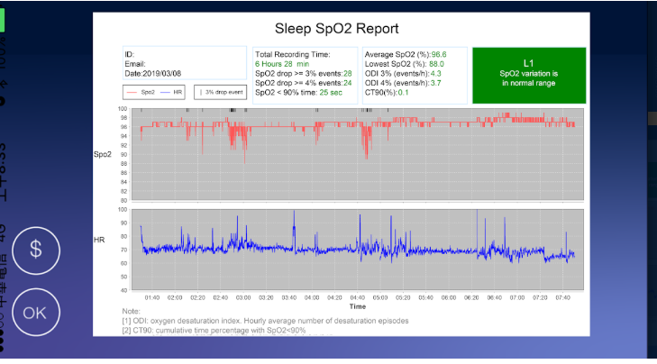
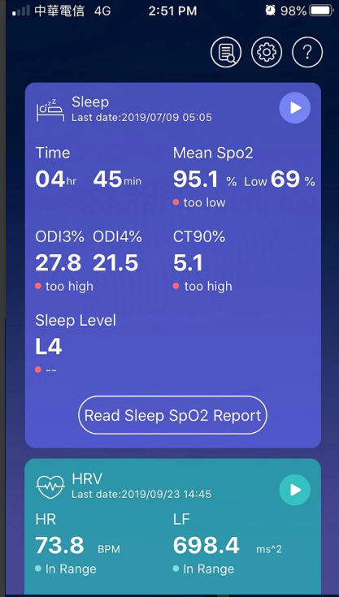
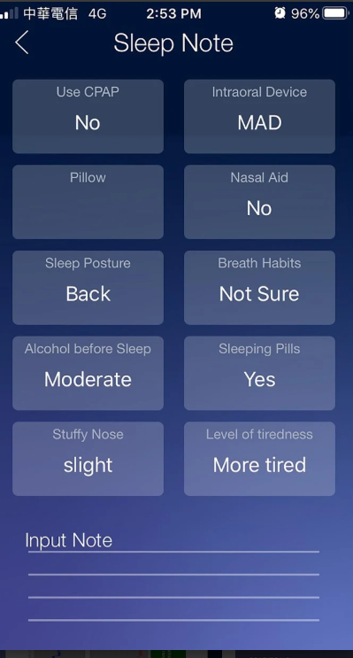
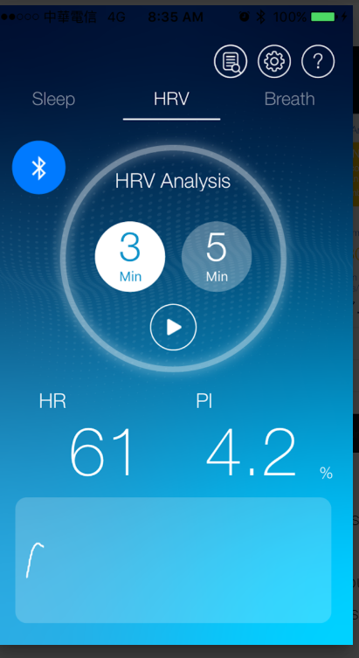
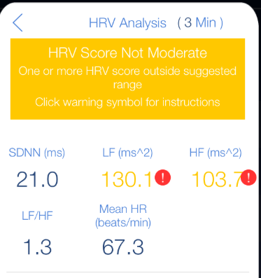
SOMI 竞品（软件应用）
iFora O2
Based in Moorpark, California, ForaCare Inc. US is a healthcare technology company dedicated to the design and development of products for chronic disease management
© 2020 Ricoh Software Research Center (Beijing) Co., Ltd.

Slide 2
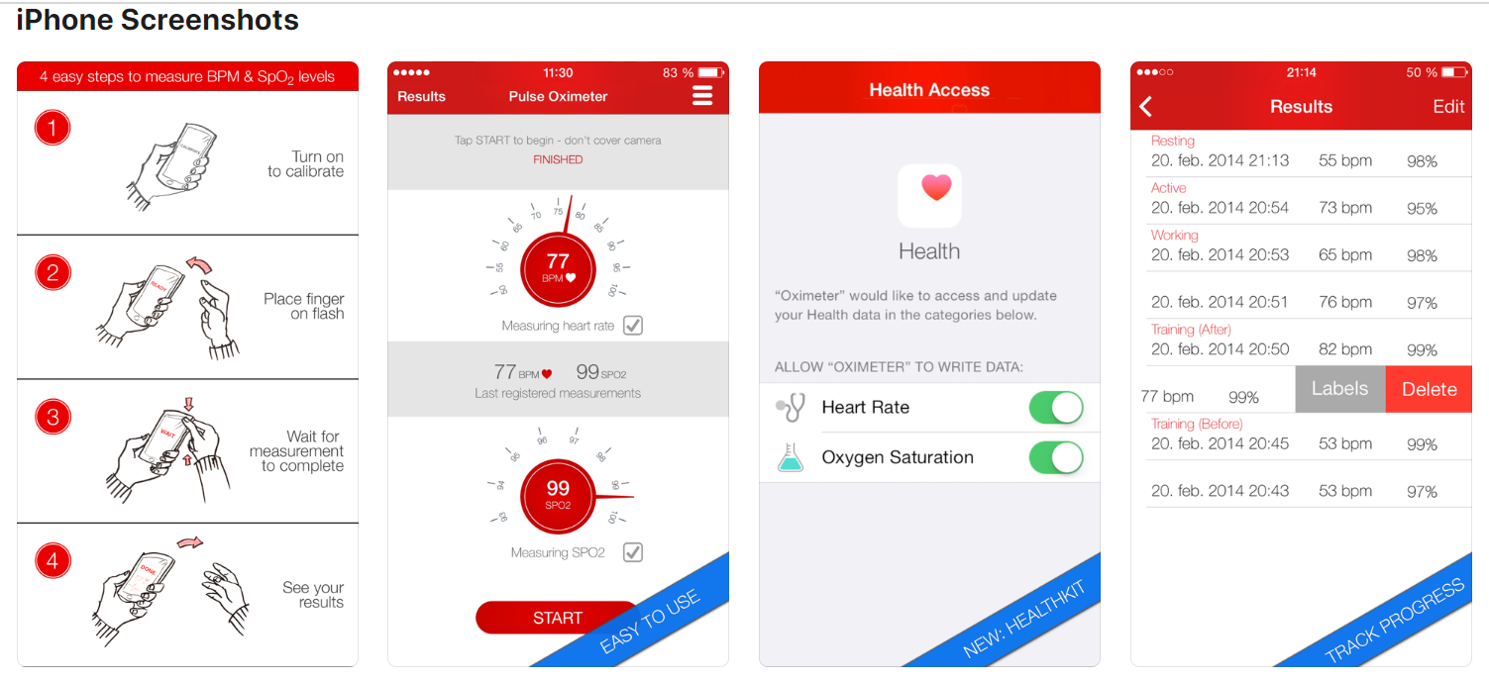
SOMI 竞品（软件应用）
Pulse Oximeter by digiDoc
App Store上排名第一的应用，直接用手机闪光灯来计算SpO2，和iPhone的健康应用紧密结合。
© 2020 Ricoh Software Research Center (Beijing) Co., Ltd.

Slide 3
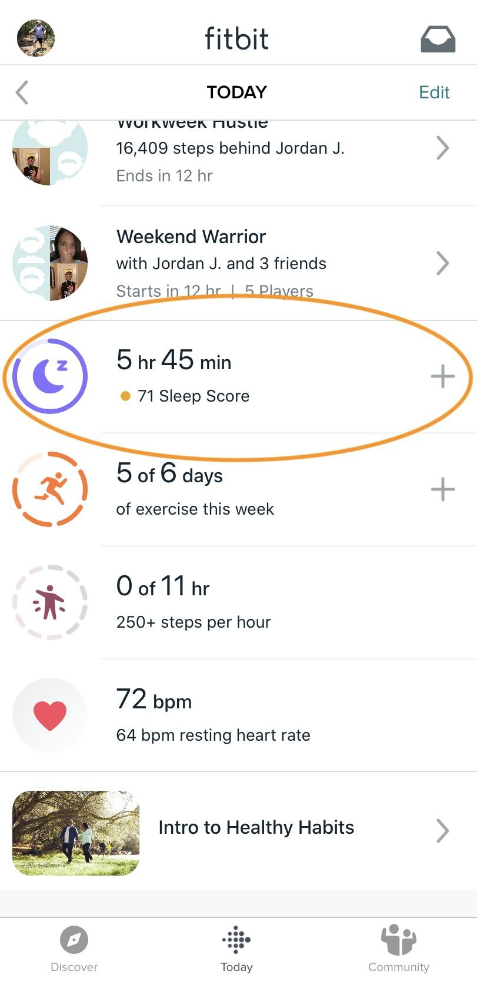
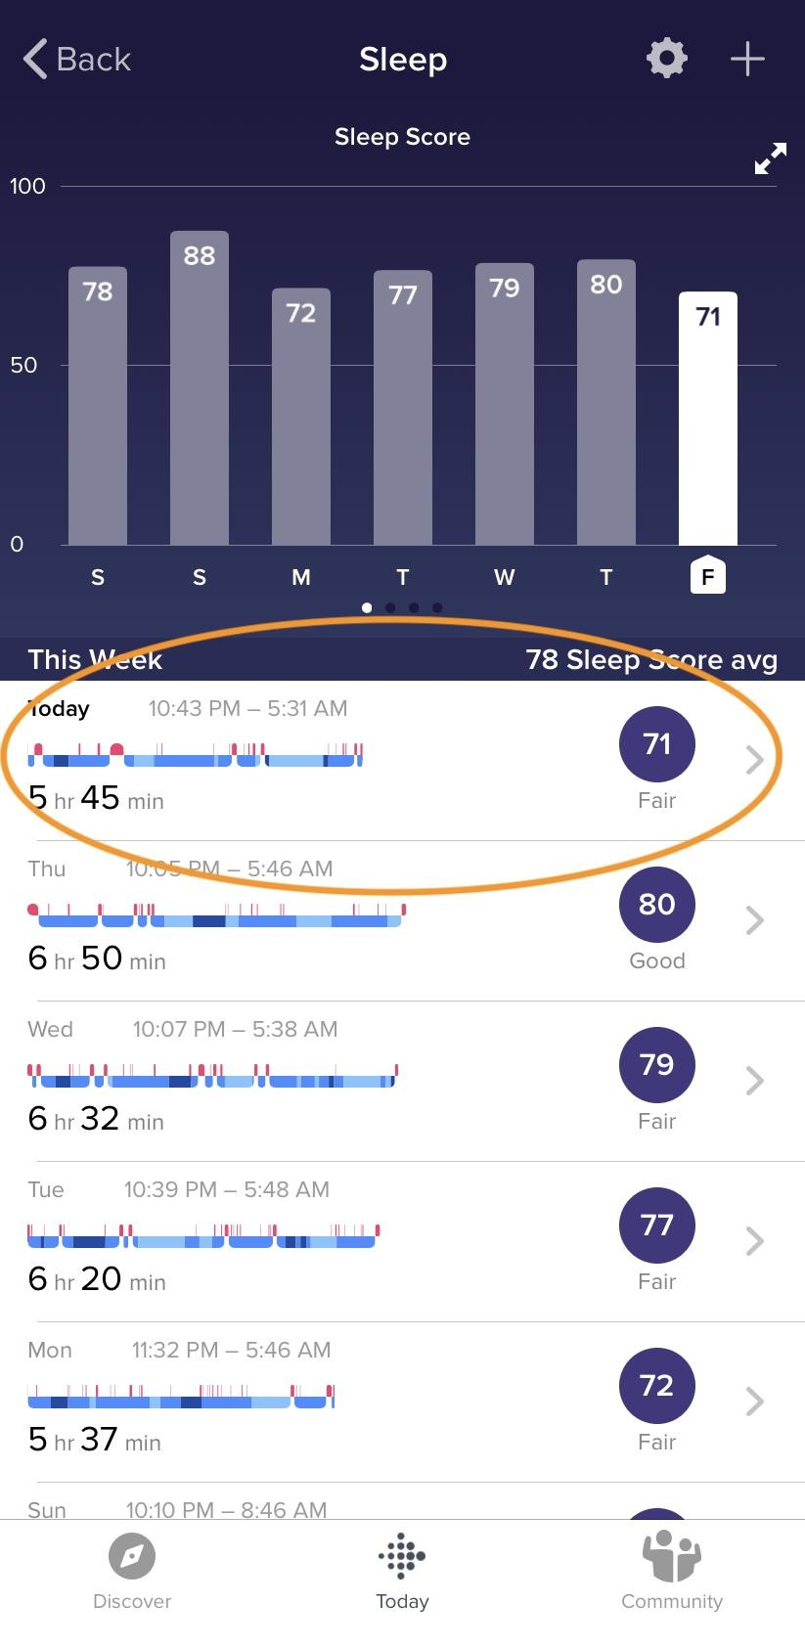
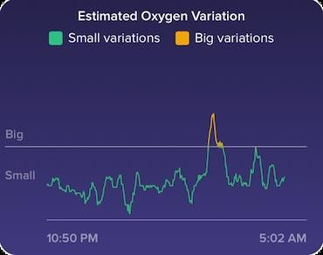
SOMI 竞品（硬件）
从去年底开始、到今年1月左右加速，主流智能手表厂商均上线了SpO2测量功能，包括华为、台湾的运动手表品牌Garmin、时尚智能手表Withings、Google旗下的Fibit等。下一代Apple Watch也被广泛预计，即将上线SpO2功能。（具体信息见备注）
下图为FitBit应用界面，用Small/Big来区分超过阈值的情况：
长远来说，可以在不限定硬件的情况下，直接从手机的健康应用（如苹果健康、华为健康等）中，读取SpO2以及相关健康数据。
© 2020 Ricoh Software Research Center (Beijing) Co., Ltd.
Notes:
https://www.imore.com/how-enable-spo2-monitor-your-fitbit
https://www.honor.cn/products/wear/magicwatch2/
https://zhuanlan.zhihu.com/p/112139401
新一代 Apple Watch 将增加血氧检测功能，血氧监测缘何呼声这么高？
https://zhuanlan.zhihu.com/p/101305560
Withings 推出新款健康手表 ScanWatch，可检测心率+血氧丨CES 2020
https://www.garmin.com.cn/garmin-technology/pulse-ox/
Pulse Ox 脉搏血氧感测功能| Garmin - 佳明Garmin
https://cn.engadget.com/cn-2020-01-16-fitbit.html
GoogleFitbit在Apple Watch之前加入SpO2功能

Slide 4
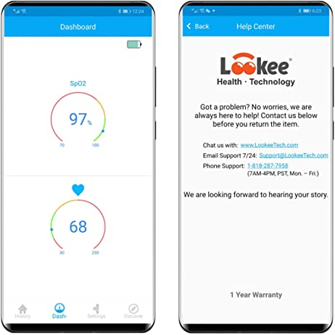
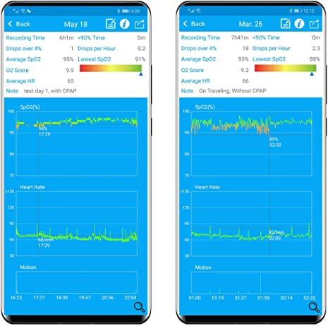
SOMI 竞品（硬件）
专用硬件有很多，价格大致从200元/30美金 –2000元/300美金。
Amazon上推荐一款比较专业的专用设备，Lookee，大约200美金。
© 2020 Ricoh Software Research Center (Beijing) Co., Ltd.
Notes:
https://www.amazon.com/LOOKEE-Vibrating-Notification-Insights-Aviation/dp/B07ZKF79Y1?ref_=ast_sto_dp

Slide 5
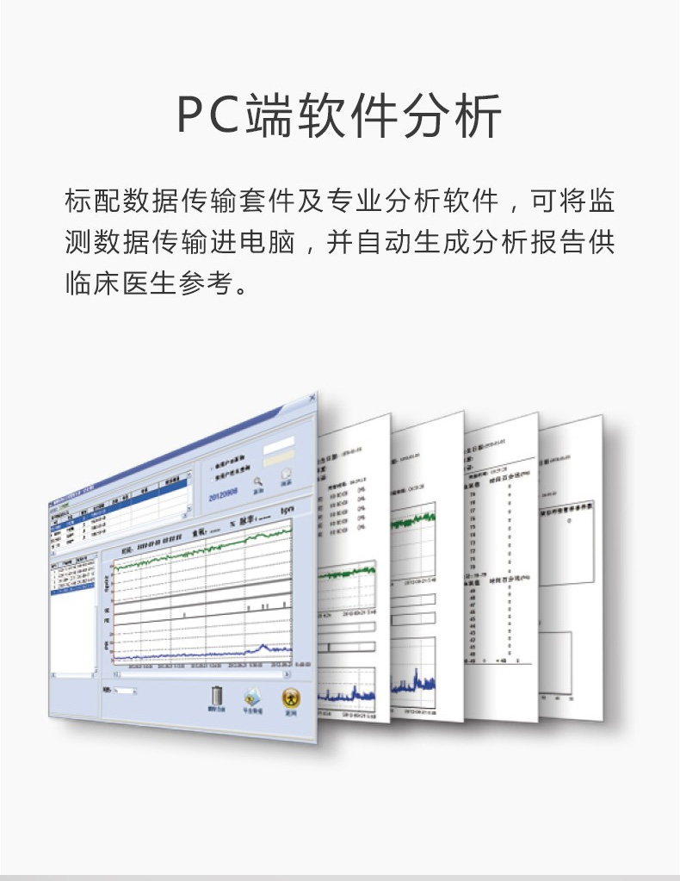
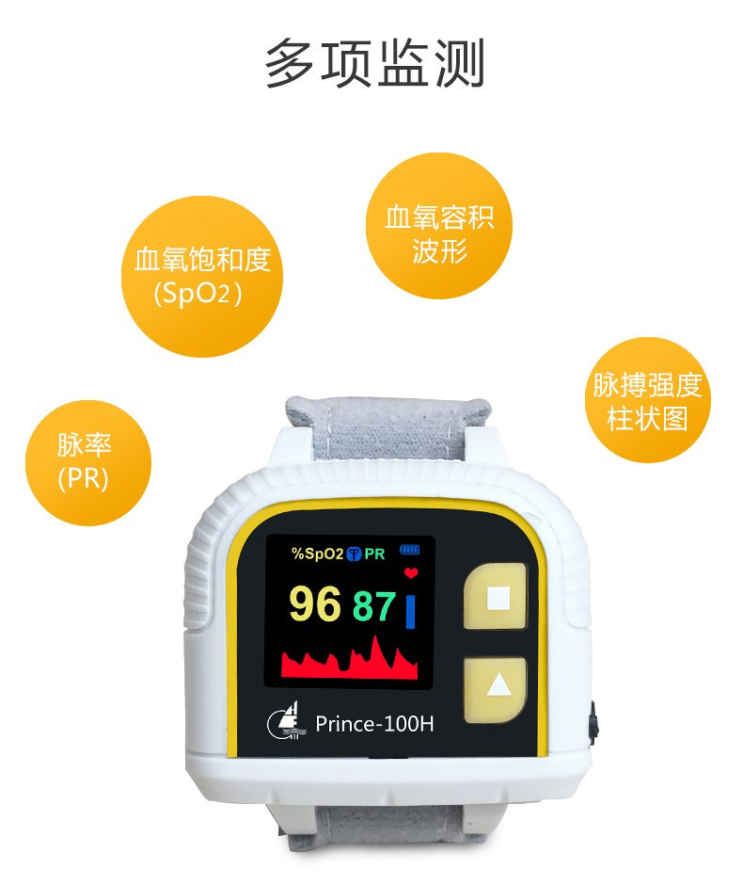
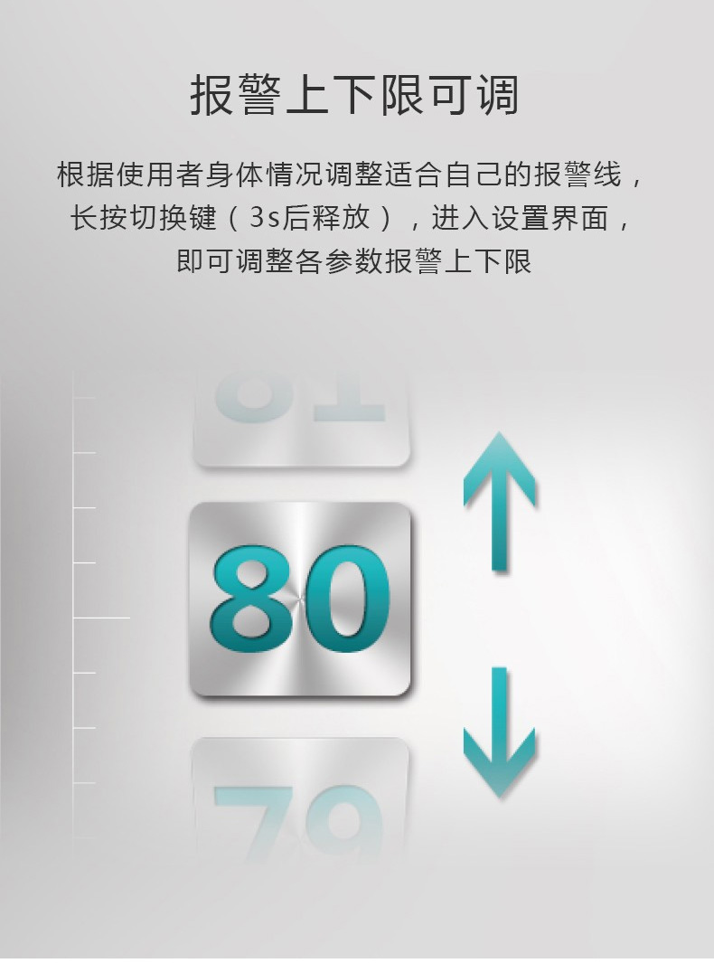
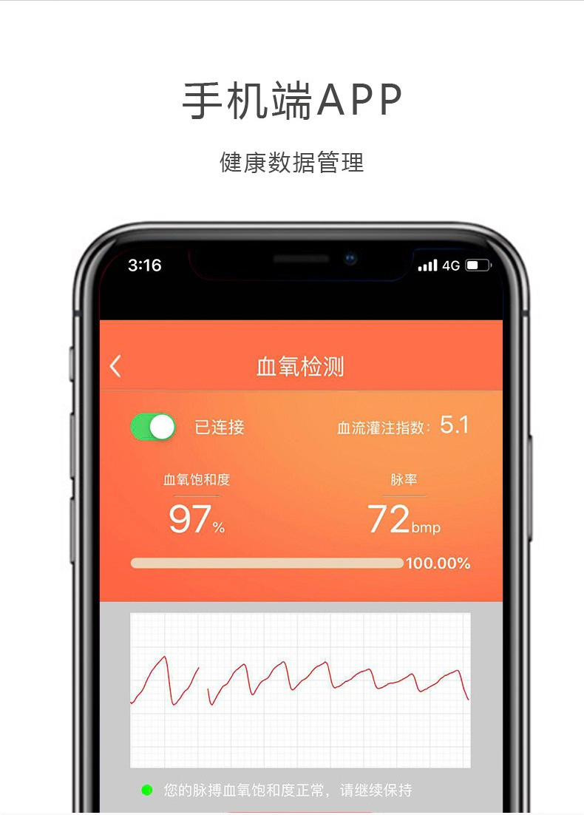
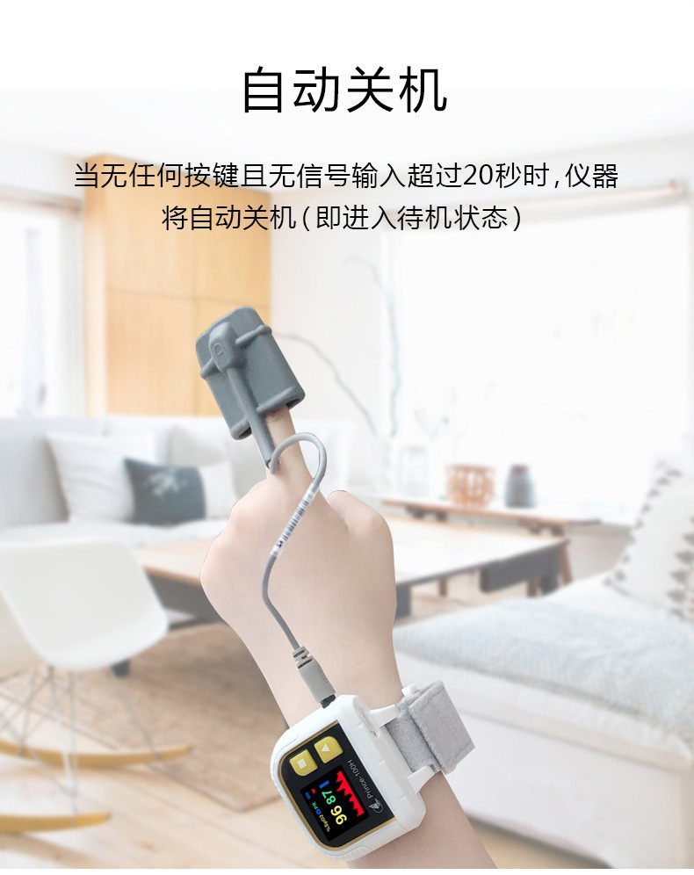
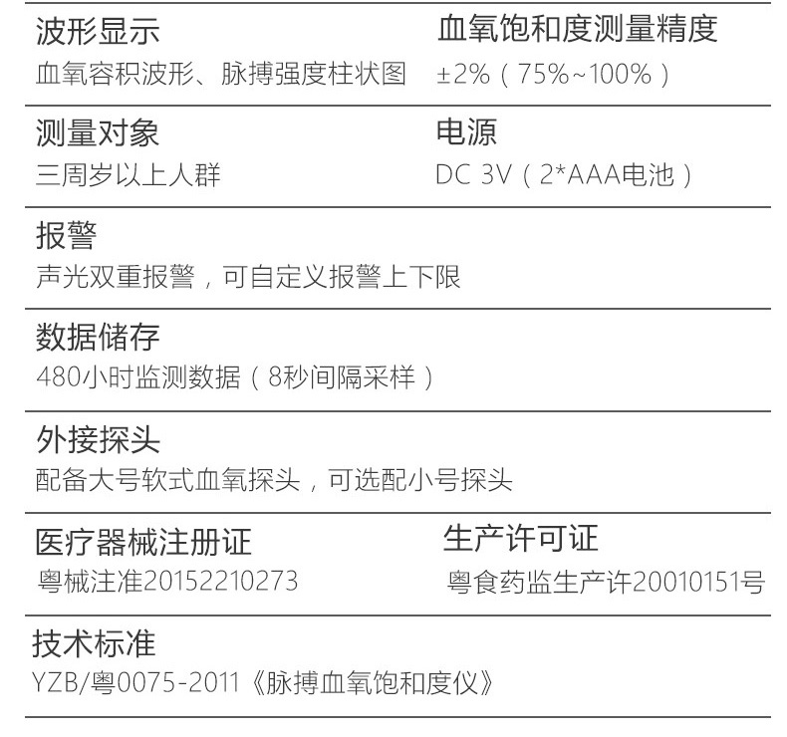
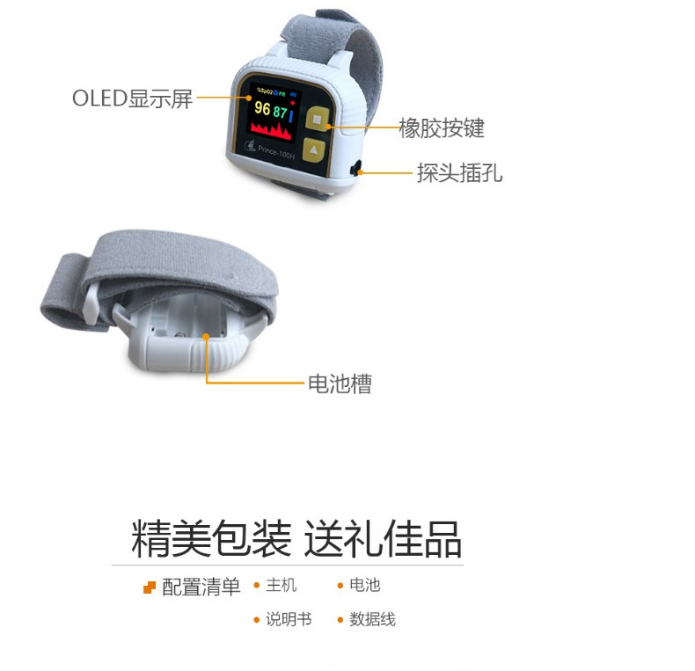
SOMI 竞品（硬件）
在国内，力康（HealForce）、康泰（CONTEC）、超思（ChoiceMMed）、理邦（EDAN）、飞利浦（PHILIPS）、鱼跃都比较活跃，有部分是主打新生儿血氧监控市场。
其中力康中间档次的一款如下，价格在980元
© 2020 Ricoh Software Research Center (Beijing) Co., Ltd.
Notes:
https://item.jd.com/58842251603.html
http://www.yuwell.com/

Slide 6
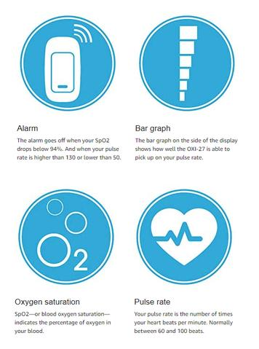
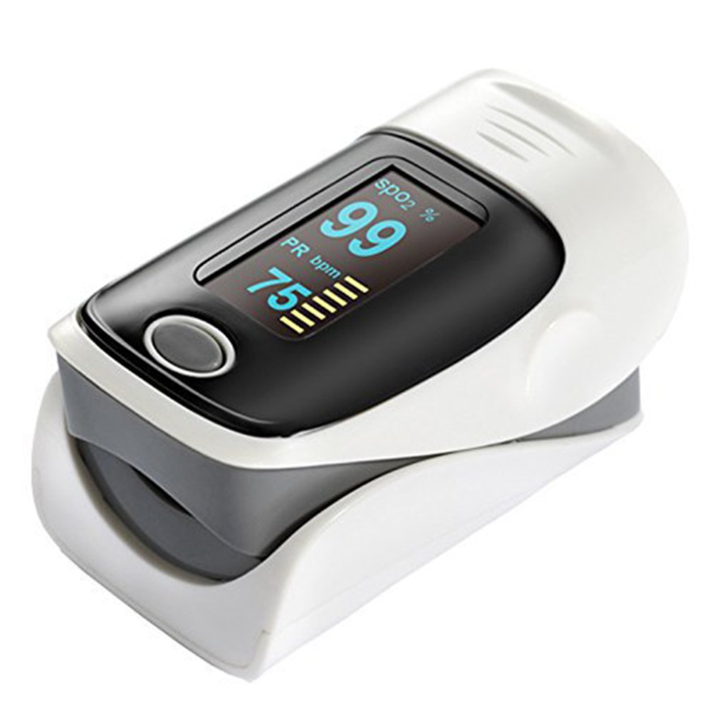
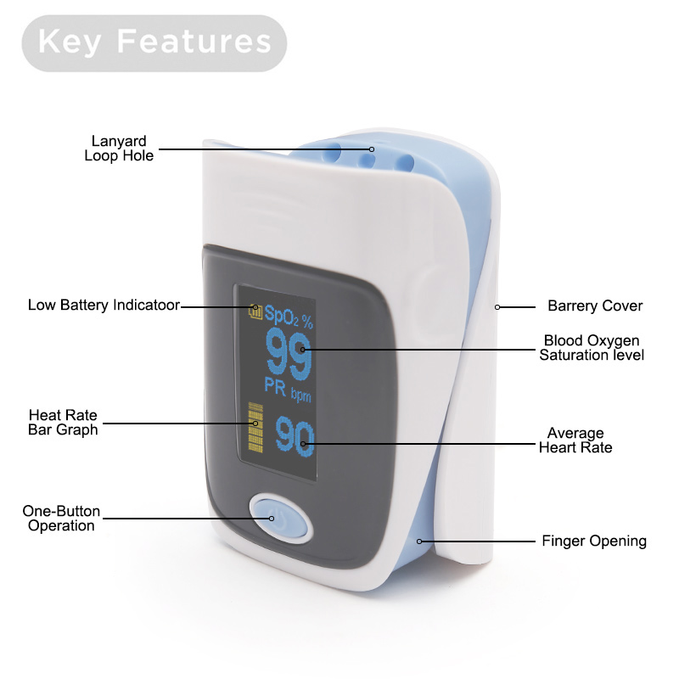
SOMI 竞品（硬件）
低端无牌/杂牌设备很多。海外市场上的杂牌设备，标价39美金：
The pulse oximeter is a small, clip-like device that attaches to a body part, like toes or an earlobe.
It can rapidly detect even small changes in how efficiently oxygen is being carried to the extremities furthest from the heart, including the legs and the arms.
Low in power consumption
Two AAA alkaline batteries
Auto turns off within 8 or 16 seconds when there is no signal.
58 * 36 * 32 mm
26.5g (without batteries)
SpO2:
Measuring range: 70 ~ 99%
Resolution: ± 1%
Accuracy: ± 3% (70% ~ 99%), unspecified (<70%)
Pulse:
Measuring range: 30 ~ 240 bpm
Resolution: ± 1%
Accuracy: ± 2bpm or ± 2% (select larger)
Low Perfusion ≤ 4%
© 2020 Ricoh Software Research Center (Beijing) Co., Ltd.
Notes:
https://speedshows.com/
If the pulse oximeter has detected your heart rate and SpO2 in an irregular state, the pulse oximeter will be an alert to alert the user to their body's condition. Also you can set the limit by yourself and or to the alarm sound effect.
If the blood flow in your finger is below a certain level, the pulse oximeter will not be able to function. pay attention to nail polish and false nails can cause false readings.

Slide 7
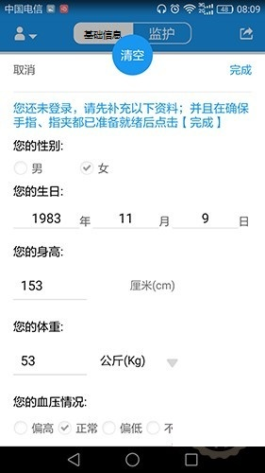
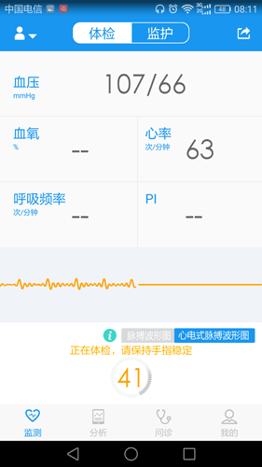
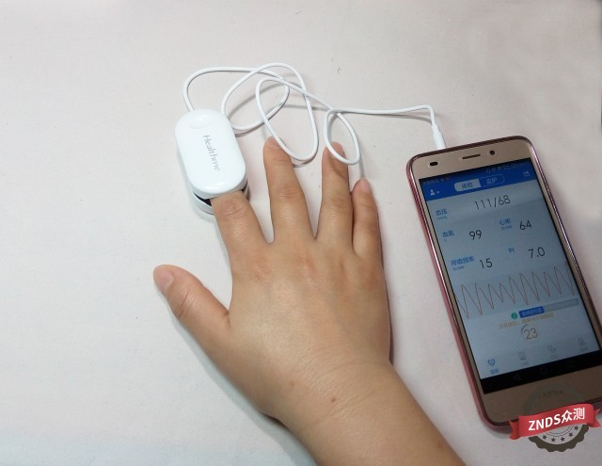
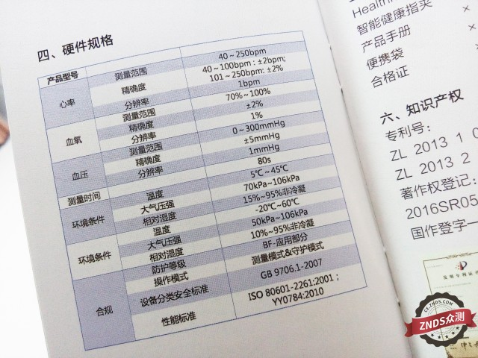
SOMI 竞品（硬件）
国内市场上的某款杂牌设备，主打自我体检，标价398元
© 2020 Ricoh Software Research Center (Beijing) Co., Ltd.
Notes:
https://you.dangbei.com/lab/46617.html

